Slide 1
Prepare for RxDC
UnitedHealthcare will submit RxDC data for all clients, but they must take action!
UHC support applies to fully insured, self-funded (ASO), that were active any time during 2025.
Employers and Brokers must have access to a portal* to complete the UHC RFI
*Employereservices; uhceservices;
Notes:
This training covers the pharmacy benefits and costs reporting required under the Consolidated Appropriations Act and includes our approach to submitting required information and tips for completing the UHC RFI.
Although UnitedHealthcare maintains most of the required data, as you may remember, some information is not stored in our systems. The RFI allows us to capture and validate data needed to submit the complete RxDC report on behalf of the fully insured, Level Funded and ASO employers we serve.
The RFI is on the employer and broker portals so it’s important for employers and brokers to have access to the portals.
We will provide links to additional resources that support the UHC approach and also links to key resources from CMS.
And we also cover our support for those ASO employers who choose to submit the data themselves.
Now let’s begin.

Slide 2
Notification to customers Feb 2 RxDC Brainshark is available
RxDC Brainshark Goal
Address UnitedHealthcare’s approach to the required CAA pharmacy benefits and costs reporting.
Cover what information is needed for UHC to submit data for all customers.
Provide information and tips for completing the RFI tool.
A customer and broker/consultant eblast with the RFI information and deadline, UHC RxDC worksheet and a RxDC Brainshark recording will go out by February 2, 2026.
The RxDC Brainshark is external and therefore available for the employers, brokers and consultants.
Brainshark timing is ~ 40 minutes for the entire presentation.
Navigation in the Brainshark is simple.
Just click on where you want to go on the left and you will jump there.
You can go back to earlier information by clicking back on that slide.
ASO customers who want UnitedHealthcare to provide their data so they can submit it directly to CMS must notify us by March 31, 2026.
RxDC Brainshark Link
Notes:
A UHC customer and broker/consultant eblast will be sent beginning January 28 and January 29 and before Feb 1 before the RFI opens. And the UMR communication email goes out with a link to the UMR RFI on Monday, Feb 2.
The UHC RxDC eblast includes RFI information, key deadlines, a worksheet and Guide, FAQs and a Brainshark recording.
You also have a RxDC RFI customer email available to you in the Jan 14th Sales Source article and on One Connect. You should send this RxDC email to your customer contact by February 15th to ensure your customer contact has received it. And send the email to brokers where appropriate.
The Brainshark covers all the important information. Therefore, we recommend that you instruct and encourage the customers and brokers to listen to the Brainshark recording at least once. The Brainshark recording is flexible and allows the viewer to click where they want to go at any time.

Slide 3
Important Reminders
1
2
3
UHC employers, including Surest, will be able to access the UHC RFI tool from the employer/broker portal starting February 1, 2026.
Note: Customers who offer both Surest and UHC are only required to complete one RFI.
Employers must have access to a portal to complete the RFI:
UHC eServices
Employer eServices
When accessing the UHC RFI on the portal, customers can view data from the prior year to help complete this year’s UHC RFI by selecting “Prior Years RFI” from the left navigation menu.
Brokers that are listed as the broker of record in UHC’s system by 1/15/2026, may check the status for a specific customer in the UHC RFI tool.
Notes:
Let’s review a few important reminders for the 2025 reference year which we will cover in more detail throughout the training.
Customers with UHC and Surest only need to complete one RFI on one of the portals.
If the customer has fully insured and self-funded plans, they will need to complete two RFIs.
If the customer wants to review the data they provided last year, it will be available in the RFI tool.
And the RFI tool allows information to be partially completed and saved. It can be reopened to add or change information any time prior to March 31.
The RFI tool is built into both the employer and broker portals. The portal indicates customer status.
The broker can also work with their UHC account rep as the deadline approaches to get the status of all customers they manage rather than checking on each customer one at a time.

Slide 4

UnitedHealthcare Approach to Support Employers
Notes:
Now let’s take a look at UnitedHealthcare’s approach to submitting the RxDC information for all employers.

Slide 5

UnitedHealthcare support for employers
There is no fee for this service.
Customers who offer both Surest and UHC are only required to complete one RFI.
Customers are required to complete an RFI for each funding type (fully insured and ASO), if applicable
Customers who offer both UHC/Surest will be required to complete one UHC RFI on the portal a
The RFI must be completed even if coverage was not in effect for the entire 12 months of the reference year.
If the RFI is not completed by the deadline, UHC will submit only the data in our system(s). However, the submission will NOT be complete.
Employers that do not complete the RFI are required to submit the missing data directly to CMS through the CMS portal.
Self-funded/ASO alternative: Upon request, UnitedHealthcare will provide data to self-funded employers who wish to submit the report directly to CMS through the CMS portal.
If this approach is selected, the employer decision must be received by UHC by March 31, 2026.
Data will be sent to the requestor May 15, 2026.
UnitedHealthcare will not accept requests for fully insured and Level Funded employers to submit all data directly to CMS through the CMS portal.
Employers who use other PBMs, including OptumRx direct (carve out): The customers must work with that PBM or carrier to submit the data directly to CMS by the required June 1, 2026, deadline.
Notes:
UnitedHealthcare will submit the required data for all employers including the appropriate narratives. There is no fee for this service.
To submit a complete RxDC report to CMS, UnitedHealthcare must collect the data we don’t have by the March 31 deadline. There can be no extension to this date.
Customers who offer both Surest and UHC are required to complete just one RFI on the employer/broker portal.
Customers are required to complete an RFI for each funding type (fully insured and ASO).
Customers who offer both UHC and Surest as well as UMR will be required to complete one RFI on the portal for UHC and Surest and to provide the information requested in the UMR RFI email.
The RFI must be completed even if coverage was not in effect for the entire 12 months in 2025.
If the RFI is not completed and submitted in the RFI by the deadline, we will submit only the data in our system(s).
This means the customer must submit that data we had not collected directly to CMS through the CMS portal.
Upon request, we will provide data to self-funded employers who wish to submit the report to the CMS portal themselves if they notify their account team by March 31.
If you are the account representative, you must update the UHC customer data submission Ad Hoc tool by April 15. For customers submitting their own data, we remove that customer’s data from our June 1 submission to CMS.
And for UMR, the UMR customer self-report request must be received by the UMR HCR (healthcare reform) Team by March 31.
There is a fee for providing customers with the integrated pharmacy D3 to D8 data.
By May 15, we will send data to the person who requested the data.
This approach is not permissible for fully insured or Level Funded customers.
For employers who use other PBMs, including OptumRx direct (carve out): The customers must work with that PBM or carrier to submit the data directly to CMS by the required June 1 deadline.

Slide 6

UnitedHealthcare support for cancelled employers
The RFI tool in the employer portal also applies to cancelled groups that were active any time during the 2025 reference year.
If the cancelled employer completes the RFI, UnitedHealthcare will submit the RxDC data for time they were active.
If a cancelled employer does not complete the RFI, UnitedHealthcare will submit what we have in our systems by June 1, 2026, directly to CMS.
The cancelled employer will be responsible for submitting any data that UnitedHealthcare does not submit directly to CMS.
Cancelled employers will still have access to the portal but may need to request a new password to complete the UHC RFI.
Notes:
It's important to know that UnitedHealthcare also supports employers who have cancelled but were active for any time during the 2025 reference year.
Just like current customers, if the employer does not provide the requested data to UnitedHealthcare in the RFI tool. It is the responsibility of the employer to submit the missing information to CMS.
If a cancelled employer no longer has access to the portal, they may request a new password when they go to sign into the portal.

Slide 7

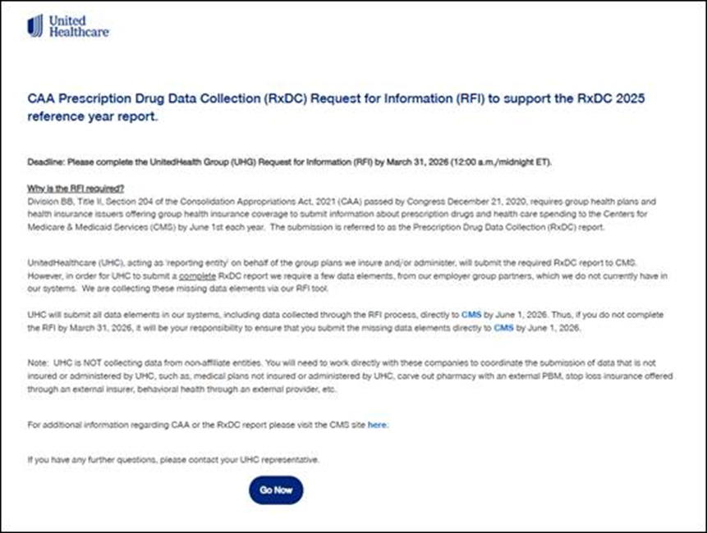
Sample screenshots from uhceservices
On uhceservices the entry screen to get to RFI is slightly different.
Click on Important Action Learn More…then Go Now

Slide 8
Information required by insurer or plan
Plans, issuers, and carriers must submit one or more plan lists (P1, P2, P3), eight data files (D1 through D8), and a narrative response, where appropriate.
Identifiers beginning with P stand for Plan
P1: Individual and Student Market plans P2: Group Health plan list (most commercial business) required for employer-based health plans
Identifiers beginning with D stand for Data and reference the 8 distinct files of data required in the report.
D1: Premium and Life Years D2: Spending by Category D3: Top 50 Most Frequent Brand Drugs D4: Top 50 Most Costly Drugs D5: Top 50 Drugs by Spending Increase D6: Rx Totals D7: Rx Rebates by Therapeutic Class D8: Rx Rebates for the Top 25 Drugs
Notes:
Under the Consolidated Appropriations Act, health insurers offering group or individual health coverage, and self-funded group health plans are required to report data annually regarding prescription drugs and health care spending.
CMS data layout organized the plan and data submission into categories.
Plans, issuers, and carriers must submit one or more plan lists (P1, P2, P3), eight data files (D1 through D8), and a narrative response.
The plan lists information is identified by a P for Plan. For example:
P2 is for most commercial employers
There are eight distinct data files required in the RxDC report. These are:
D1, which is for enrollment and premium information. This file includes average monthly premiums paid by the employees or the employer
D2 is for total health care spending, broken down by type of cost such as hospital care, primary care, specialty care, and other medical costs by enrollee, employer or insurer. It also includes total Prescription drug spending by enrollees, employers or insurers.
Then D3 through D8 covers prescription drug information based on different criteria. For example:
D3 addresses the 50 most frequently dispensed brand prescription drugs
D4 applies to the fifty costliest prescription drugs by total annual spending
D5 is the fifty prescription drugs with the greatest increase in plan or coverage expenditures from the prior year
D6 is the pharmacy totals
And finally, D7 and D8 require data for prescription drug rebates, fees, and other payments made by drug manufacturers including the impact of rebates on premium and out-of-pocket costs for each therapeutic class of drugs and for each of the twenty-five drugs with the highest amount of rebates.

Slide 9
Preparing for and completing the UHC RFI
Notes:
We want to make it easy for customers to submit the information in the RFI.
As we noted, completion of the RFI will enable UHC to submit ALL the required RxDC data for UHC insured or administered plans.
To prepare for completing the RFI, we have developed a worksheet mirroring the questions asked in the RFI portal.
After completing the RFI, assuming the employer has no other coverage with a non-affiliated carrier, vendor, or PBM, there will be nothing else for them to do.
If the employer has coverage with a non-affiliated carrier, vendor, or PBM, the employer will need to work with those organizations to submit the required data.

Slide 10
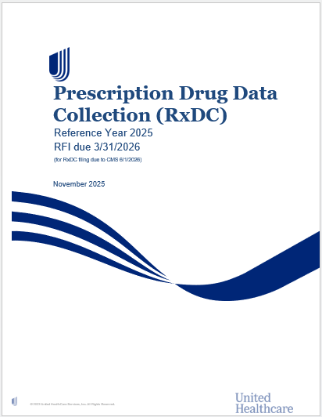
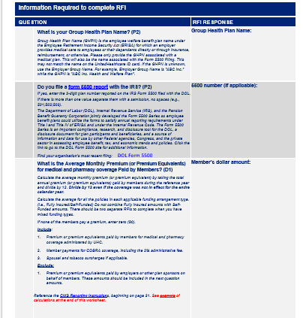
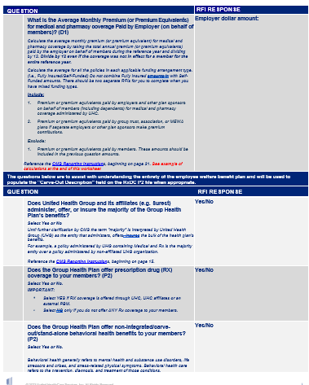
Step 1: Complete the UHC worksheet
UHC RxDC RFI Worksheet
Notes:
Here is a snapshot of the UHC worksheet, and the link is on the slide.
Completing the worksheet in advance will help speed up the process. If the worksheet is completed before entering information into the UHC RFI, it should take no more than 5 or 10 minutes to key the required data in the RFI.
The worksheet is for the customer/broker use only, it should NOT be submitted to you or to us. It’s only a tool.

Slide 11
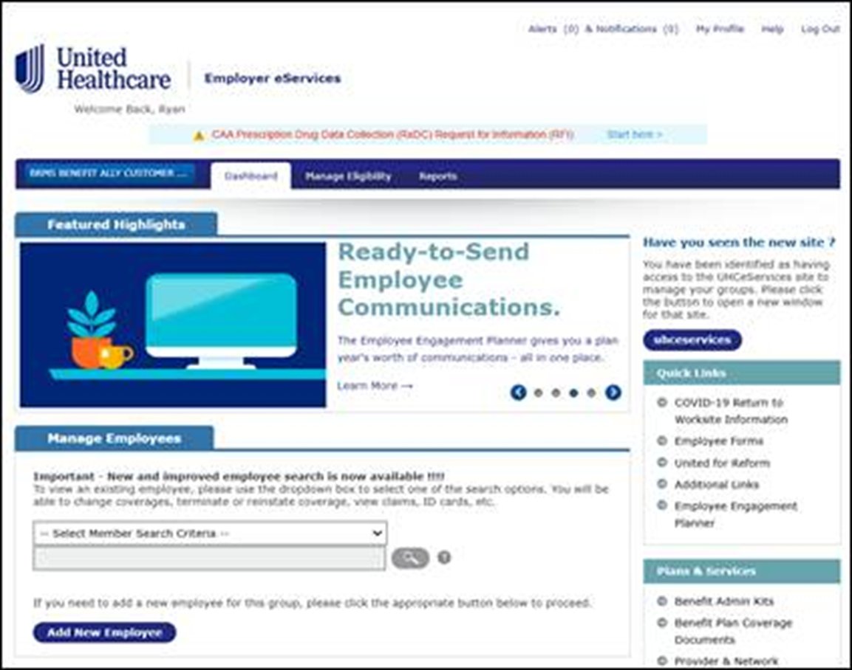
Step 2: Enter portal and complete UHC RFI screens
Login using your HSID and password.
RFI Entrance – Start Here
Screen view is for the Employer eservices portal; other portal screens may have different entry point on their home page.
Notes:
This screen and the next few screens illustrate how to find the UHC RFI on the Employer eServices portal.
The employereservices portal is shown. The uhceservices portal other portals may have slight variations. However, you will be able to access the UHC RFI from each employer and broker portal.
Screen shots for the other portals are in the appendix.
Users will log in to the Employer or Broker portal, using their login and ID.
Once authenticated, the employer/broker portal displays a highlighted message at the top of the screen in the Green Circle illustrated here, with the message CAA Pharmacy Benefits and Cost Reporting Start here.
By clicking “start here” message, it opens the UHC RFI and a legal disclaimer. From there the customer or broker will get access to the UHC RFI tool.

Slide 12
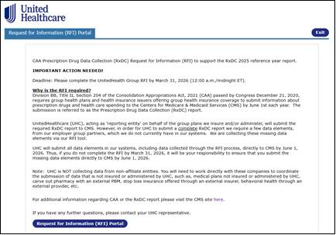
Screen reminder of deadlines and UHC RFI rationale
Key deadlines
Rationale for asking for the data and completing the RFI
Information on employer requirement if RFI is not completed
Click the UHC request for information (RFI) portal button to get started
Screen view is for the employereservices portal; other portal screens may have slight variations.
Notes:
The customer or broker clicks the UHC RFI Portal button to get started.
Remember that the UHC RFI opens February 1, 2026. And also remember that the RFI information must be completed, attested, and submitted before the March 31deadline or the employer will be responsible for submitting any missing data directly to CMS.
The functionality of the RFI allows the keyer to stop, start and continue the data submission until it’s complete.
Users will also have the option to export and print the information for reference.

Slide 13
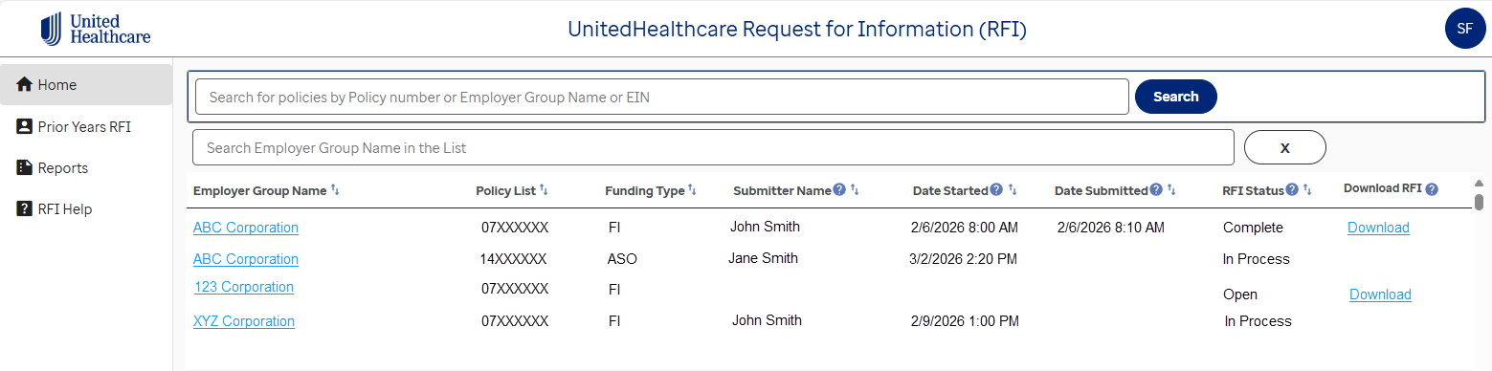
UHC RFI Home page for employers and brokers
Broker will see the list of their employer plans if BOR is accurate as of 1/15/2026
Employers will only see their own plans
If RFI has both funding type, both RFIs are required
To complete the UHC RFI, click on the Employer Group Name to open
Users can start, update, modify, submit, resubmit and download until 3/31/2026
The employer may check status real time and download completed UHC RFI responses
Deadline to submit UHC RFI is 3/31/2026
Any incorrect information (e.g., EIN, Employer Group Name) should be submitted to caa_rxdc_tech_support@uhc.com
Notes:
This slide shows a snapshot of the RFI Home screen.
On the HOME screen, the screen has the employer, policies the end-user has access to, status of the RFI, and other key info.
Brokers who manage multiple employers will have access to all employers aligned to them as of February 1, 2025.
If a customer has both fully insured and ASO, they will see both funding types. Both RFIs must be completed individually.
In this illustration, you can see that ABC corporation has a fully insured and an ASO policy.
As you can see, the fully insured RFI is complete, and the ASO is Open but not complete.
The employer would need to complete both RFIs for ABC Corporation to be considered “complete”.
As an account representatives, you will have access to the ‘Home’ screen which allows you to check status for all customer you are aligned to.
There are 3 statuses: OPEN, IN PROCESS, and COMPLETE
Any RFIs left “open” or “in process” WILL NOT be included in the submission.
Thus, if the employer DOES NOT submit an RFI to UHC they must submit this specific data to CMS directly by June 1, 2025.
T
o get to the RFI, simply click on the Employer Group Name link.

Slide 14
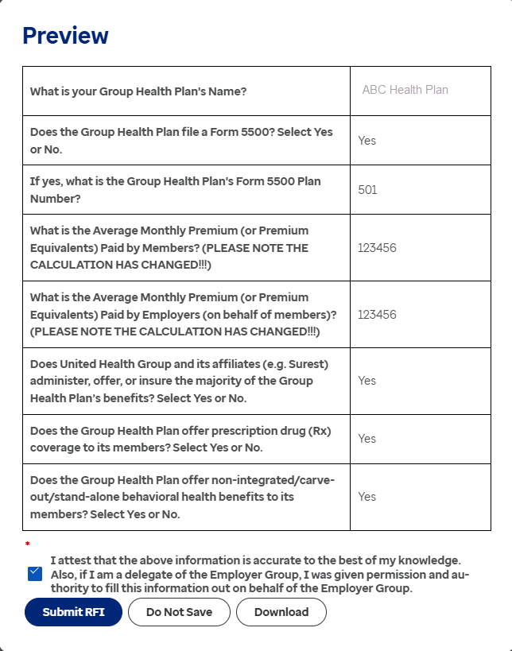
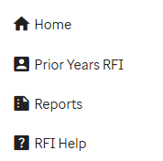
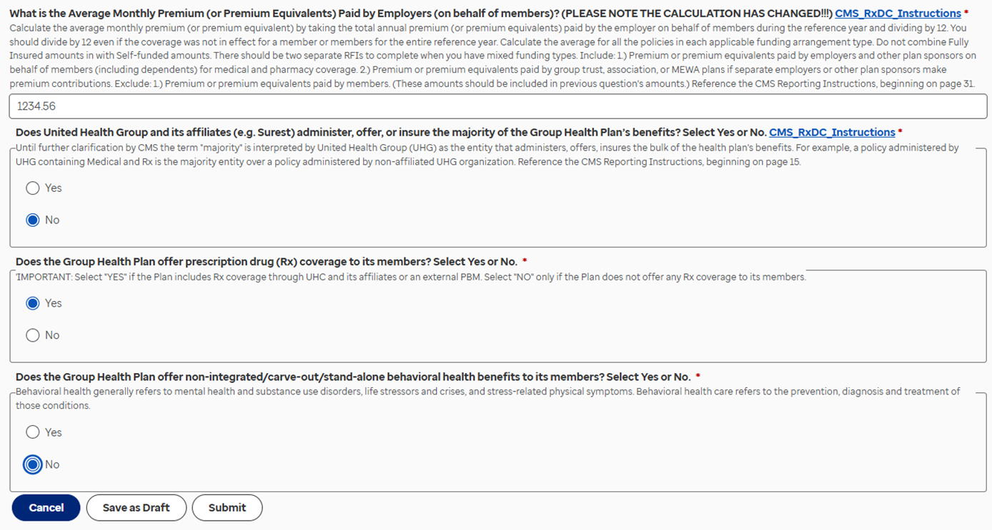
UnitedHealthcare complete, confirm, attest, submit UHC RFI
Important: Any RFI where the RFI Status is “Open” or “In Process” (i.e., not “Complete”) after UHC’s internal deadline of 3/31/2026 will not be included in UHC’s submission to CMS.
Notes:
Once the customer or end-user chooses to submit, they will be presented with a ‘Preview’ screen.
If final, they will need to attest to the accuracy of the information AND that they were given authority to submit this data on behalf of the plan.
Even after the end-user selects the “Submit RFI” button they can still go back and make changes up until March 31, 2026.
Remember, any RFIs left in process or open will not be included in the submission.
Also, remember, if any information is not entered or the RFI is not completed, then the employer must submit the missing P2 and D1 data. D1)

Slide 15

Calculation Instructions: Average Monthly Premium Paid (D1)
Notes:
Let’s review a few key items to address premium and life years data.
As mentioned earlier the RFI tool was created to capture 5 pieces of information we do not have in our UHC systems. The next 5 slides cover 2 of the more critical missing data points: average monthly premium paid by members and average monthly premium paid by employers on behalf of members.

Slide 16
D1: Calculating the premium and life years
Calculations needed to report average monthly premium paid by members and by employers
Note: Premium must be submitted by carve out carriers/vendors, as necessary.
Use the UHC RxDC worksheet to do the calculation.
Refer to the Prescription Drug Data Collection (RxDC) Reporting Instructions for definitions.
Action customers/brokers must calculate.
Information in UHC systems for plans administered by UHC. No action for customers/brokers.
Notes:
Here is a partial snapshot of the D1 filing.
The first boxes on the left are the 2 critical pieces of information missing from our databases. Essentially what we are trying to get to is the percentage split between what the member paid into the plan and what the employer paid into the plan on behalf of the member.
We will be going over 2 examples shortly.
Two important points…
First, all information in the D1 filing is based on medical and pharmacy benefits in 2025.
Second, when the employer group calculates the average monthly premium paid or AMPP, the number they use should include costs incurred under UnitedHealthcare arrangements only. It should also include stop loss provided by UHC for self-funded groups.
If stop loss is administered by a non-affiliated insurance company, the employer group must work with those insurance companies directly.
More information on these calculations can be found in the Prescription Drug Data Collection Reporting Instructions link the ‘Resource’ slide.

Slide 17
Customer must calculate member and employer premiums
Data Field | Average Monthly Premium Calculation Instructions
Average monthly premium paid by members | Include: Premium paid by members for medical and pharmacy coverage. Premium equivalents paid by members for self-funded medical and pharmacy coverage. If members do not pay a premium, enter $0 (zero) in this field. Exclude: Premium paid by employers or other plan sponsors on behalf of members. Premium equivalents paid by employers or other plan sponsors on behalf of member.
Average monthly premium paid by employers | Include: Premium paid by employers and other plan sponsors on behalf of members (including dependents) for medical and pharmacy coverage. Premium equivalents for self-funded medical and pharmacy coverage. Premium paid by group trust, association, or MEWA plans if separate employers or other plan sponsors make premium contributions. Exclude: Premium paid by members.
Per CMS instructions, calculations need to be at the funding arrangement level. If you have both FI and ASO, you will need to perform two separate calculations and complete two separate RFIs.
Reference: CMS Reporting Instructions
Notes:
In calculating premium paid by members, remember to include the premium paid by the member for medical and pharmacy coverage. If members do not pay a premium, enter $0 dollars in the member field.
It’s important for the employer not to include the premium or premium equivalents paid by the employer or other plan sponsors on behalf of the member.
In calculating premium paid by the employer, include the premium or premium equivalents for self-funded groups paid by the employer on behalf of the member for medical and pharmacy coverage.
Self-funded plans may use premium equivalent, which is the total plan cost for the employer minus the premium paid by members.
Include the premium paid by group trust, association, or MEWA plans if separate employers or other plan sponsors make premium contributions.
It’s important for the employer not to include the premium paid by the member.
For customers with multiple funding arrangements, calculations must be made separately by funding type.
For detailed questions, refer to the CMS Reporting Instructions.

Slide 18
Illustration example: full calendar year membership
In this example:
Employer has a medical policy with UHC for full calendar year.
Coverage period – 1/1/25 – 12/31/25.
Calendar period – 1/1/25 – 12/31/25
Employer paid portion is 70% of the total plan premium (or premium equivalents) paid.
Divide by 12 even if the coverage was not in effect for the entire 12 months of the reference year.
Average Monthly Premium Paid by Members = Total A divided by 12
Calculation: $82,167 / 12 = $6,847.29
Amount to Populate RFI
Average Monthly Premium Paid by Employers = Total B divided by 12
Calculation: $191,724 / 12 = $15,977.00
Amount to Populate RFI
Notes:
For self-funded plans, this is total plan costs minus premiums paid by members.
Based on most recent CMS instructions.
For RFIs containing multiple policies all policies should be included in the calculation.
Notes:
In this first example the employer group has coverage with UHC for the full calendar year.
In the Total Premium Paid by Members column, list the total premium paid by all members each month.
Sum these numbers up and divide by 12. This is the AMPP by members; shown here as $6,847. This is the 1st # that goes into the RFI.
In the Total Premium Paid by Employers column, list the total premium paid by the employer each month.
Sum these numbers up and divide by 12. This is the AMPP by employers; shown here as $15,977. This is the 2nd # that goes into the RFI.

Slide 19
Illustration example: partial year membership
In this example:
Employer has a medical policy with UHC thru 6/30/23.
Coverage period – 7/1/24 – 6/30/25.
Calendar period – 1/1/25 – 6/30/25
Employer paid portion is 70% of the total plan premium (or premium equivalents) paid.
Divide by 12 even if the coverage was not in effect for the entire 12 months of the reference year.
Average Monthly Premium Paid by Members = Total A divided by 12
Calculation: $38,880 / 12 = $3,239.99
Amount to Populate RFI
Average Monthly Premium Paid by Employers = Total B divided by 12
Calculation: $90,720 / 12 = $7,559.99
Amount to Populate RFI
Notes:
For self-funded plans, this is total plan costs minus premiums paid by members.
Based on most recent CMS instructions.
For RFIs containing multiple policies all policies should be included in the calculation.
Notes:
In this second example the employer has partial coverage with UHC for the 2025 year. The process and calculations remain the same. Fill out the months the plan was covered or administered by UHC and place a zero in the months where the plan was not covered or administered by UHC. The most important point here is you still need to divide the total premium paid by 12 regardless of the number of months covered.

Slide 20

Key Points to Remember
Notes:
RxDC data requirements can be a little daunting. We have tried to simplify the requirements throughout this training. Here are a few key points to remember.

Slide 21

What’s important to know about the RFI!
UnitedHealthcare will submit the RxDC data and narrative for coverage administered by UHC directly to CMS by the CMS due date of June 1, 2026.
The RFI tool asks for specific information that UHC needs to submit the required data and applicable narratives.
The UHC RFI is accessible via the employer/broker portal. Sign in to access and complete the UHC RFI fields.
Before starting the UHC RFI, the customer/broker should complete the appropriate worksheet, which will save them time.
Note: The worksheet is for customer/broker use only, it should not be submitted to UHC.
Changes can be made to the UHC RFI up until the March 31, 2026, deadline.
There is no need to complete the RFI tool if the ASO employer plans to submit all their data to CMS themselves. The customer/broker should notify UHC no later than March 31, 2026, if this approach is elected.
If the ASO employer plans to submit only a portion of their data to CMS, the employer must still complete the RFI by the March 31, 2026, deadline.
It is the obligation of the employer to submit the P2 and D1 data directly to CMS through the portal if the RFI is not completed.
Notes:
In summary, remember the following key points regarding this year’s RxDC data reporting:
1. UnitedHealthcare will submit the RxDC data and narrative for coverage administered by UnitedHealthcare (or its affiliates) including Surest and UMR and Level Funded.
2. The RFI tool asks for specific information that UHC needs in order to submit all the required data and applicable narratives for the customer.
3. The UHC RFI tool is located in the employer and broker portal. The employer or brokers must sign in to complete the UHC RFI fields.
4. Here’s a Tip! Before starting the RFI, the customer or broker should complete the UHC RFI worksheet which makes the process easier and much quicker. Remember, the worksheet is a tool and it should NOT be submitted to UHC. The customer must enter the information from the worksheet into the RFI.
5. Employers or brokers have the flexibility to make changes to the RFI through the March 31 deadline.
6. There is no need to complete the RFI tool if the ASO employer plans to submit all files themselves. However, they must notify you no later than March 31, 2026.
7. If the ASO employer plans to submit only a portion of their data to CMS, the employer must still complete the RFI by the March 31deadline.
8. If the RFI is not completed, the employer is required to submit the P2 and D1 data directly to CMS.

Slide 22
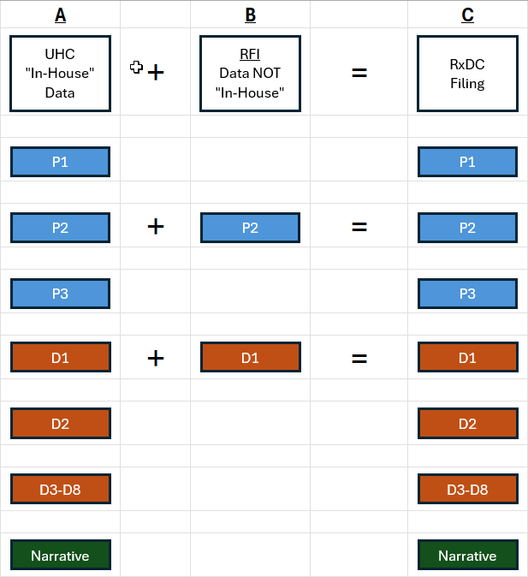
Employer did not complete RFI by 3/31, now what?
See information below for Employers that did not complete the RFI prior to UHC’s internal deadline,
UHC has most of the information required to submit the RxDC filing “in-house”.
For the information UHC does not have, an RFI allows us to collect this missing data. Responses to these questions will be used to populate 5 data points in the RxDC filing:
3 data points on the P2
2 data points on the D1
The data collected via the RFI process will be combined with UHC’s “in-house” data and filed with CMS. The RxDC submission is due to CMS 6/1/2025.
IMPORTANT: UHC will file the narrative response, where appropriate.
If the status of the “RFI Status” is “Open” or “In Process” by the March 31, 2026, deadline, none of the UHC RFI data provided will be included in UHC’s submission to CMS.
Notes:
This slide shows a screenshot from a new guide that was created for Reference Year 2025. This view shows an overview of what UHC will file directly with CMS and what the Employer is responsible for filing directly with CMS if the Employer does not complete the RFI.
As mentioned earlier, if an employer does not complete the RFI by March 31, then:
UHC will file the data that we have available in our systems directly to the CMS by June 1, 2026. The data UHC will file is outlined in column A
The Employer will be responsible for filing ONLY the data that was NOT submitted via the RFI process, directly to CMS, by June 1, 2026. The data the Employer is responsible to file is outlined in column B.
It’s important to note that if the status of the “RFI Status” is “Open” or “In Process” by the March 31, 2026, deadline, none of the RFI data provided will be included in UHC’s submission to CMS. The customer or broker completing the RFI must attest and submit it to be complete.
UHC does submit the data we do have in our system. But we do not submit RFI data if it was not complete or not submitted.

